Slide 1
DATA WRANGLING AND DATA ACQUISITION OF THE DATASETS presented by: Himanshu sharma

Slide 2
Tools and Libraries used Used following libraries to work on this project 1. Matplotlib 2. Pandas 3. Seaborn 4.Scipy 5.Jupyter Notebook

Slide 3
Introduction
. In this project Data Acquisition and Data Wrangling on dataset1 and dataset2 .
. Data Acquisition and Wrangling on dataset3 and concatenate combine_data with dataset_3.
To be worked on missing values outliers
. Check the skewness and correlation of the data .

Slide 4
OBJECTIVES:- . Provide an overview of the dataset. . Understand data wrangling techniques to clean and transform the dataset. . Use visualization and correlation analysis for insights Data cleaning
. Handling missing values and outliers
. Features transformation and visualization

Slide 5
Basic steps:- . first we use the data1 and analysis the whole data and modify the null values of the given data . . Second we use the second data2 and analysis the whole data and then modify the null values and then merge both the data ,data1 and data2. . Third we use the third data3 and analysis the whole data and concatenate the whole data.

Slide 6
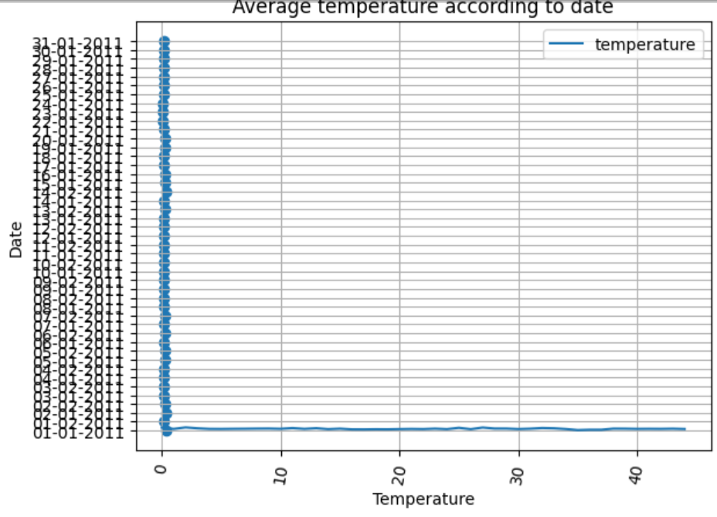

Slide 7
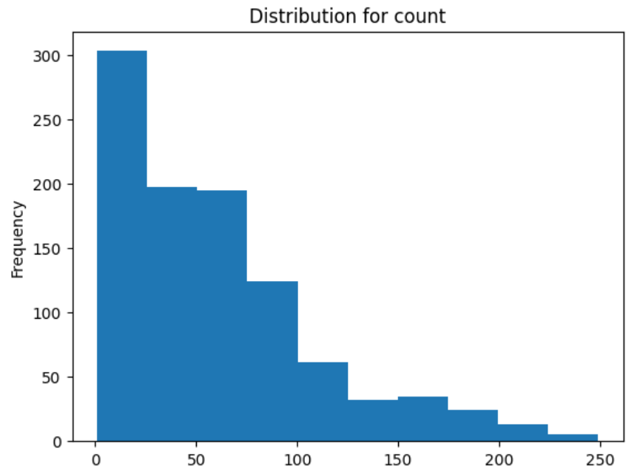
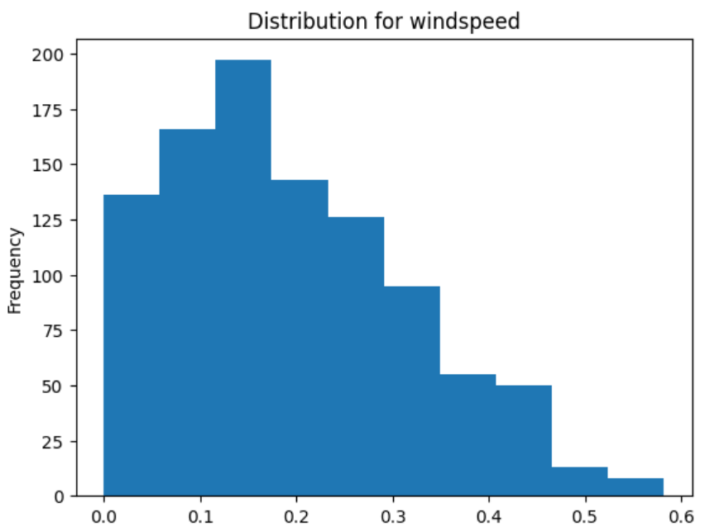

Slide 8
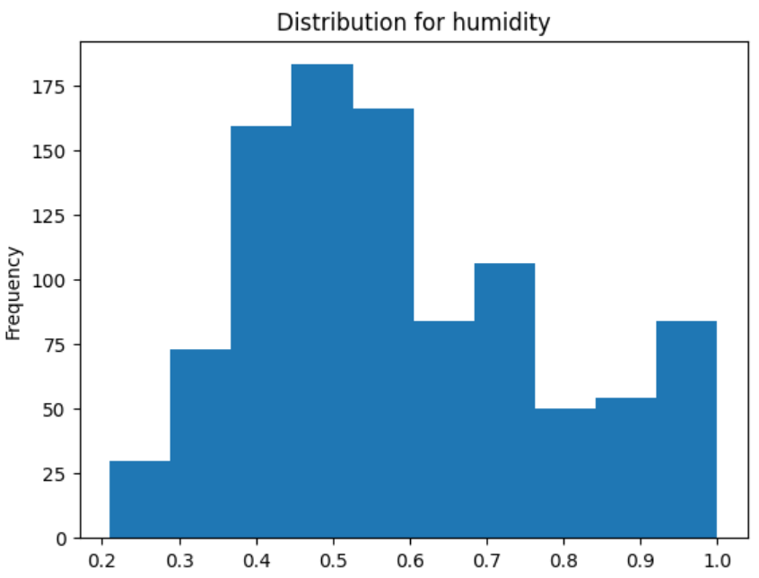
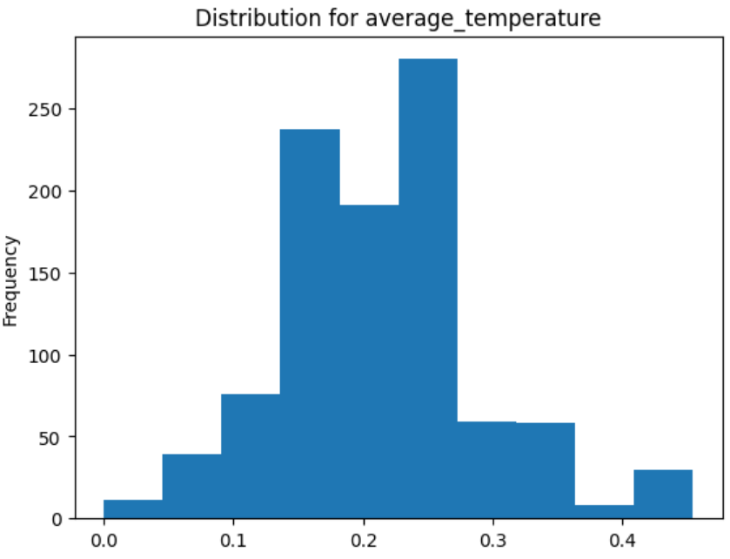

Slide 9
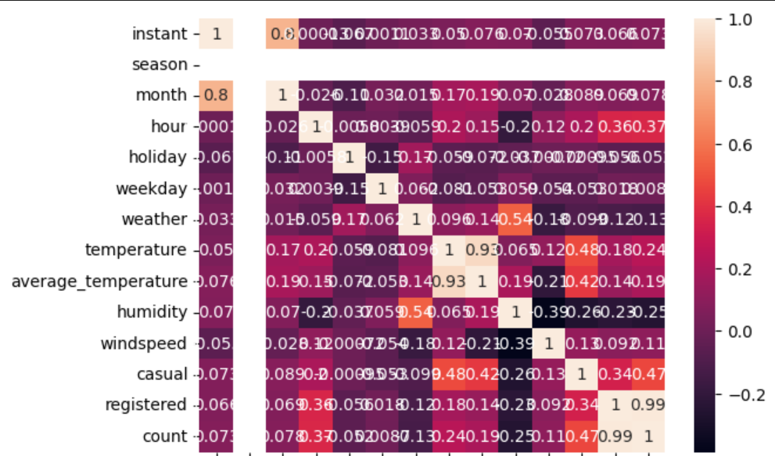
DATA VISUALIZATION . Visualize key features and distribution . Use matplotlib and seaborn to plot graphs histogram and heatmaps.

Slide 10
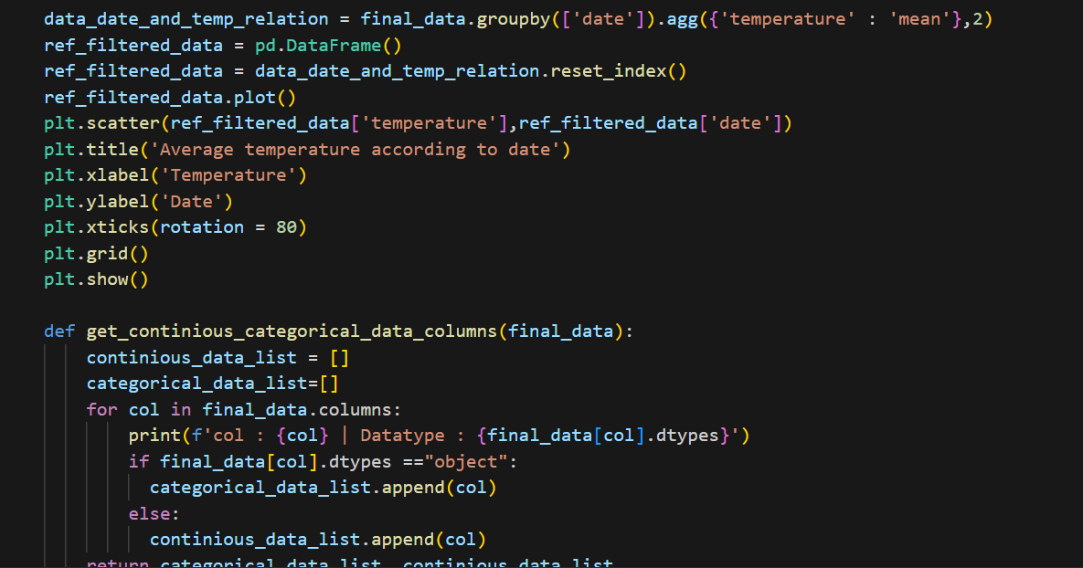
OUTPUT . In the data wrangling and data acquisition of the dataset1,dataset2 and dataset3 and merge all the given data sets.

Slide 11
CONCLUSION . Highlight the importance of data wrangling for better insight. . How these methods the quality of the dataset and made it suitable or analysis. . Further steps could include modeling or feature engineering. . Stress the importance of through data wrangling before machine learning.
.

Slide 12
THANK YOU

